Slide 1
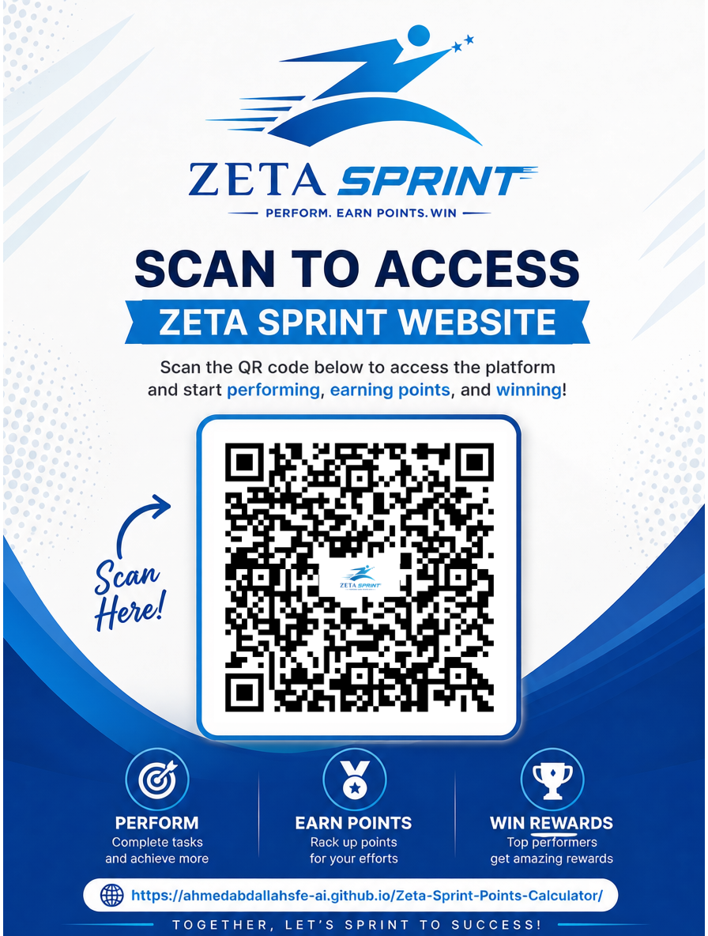
ZETA SPRINT
2026 Sales Competition
Points Calculator & Complete Guide
June - December 2026 | 7 Months | All Roles
https://ahmedabdallahsfe-ai.github.io/Zeta-Sprint-Points-Calculator/
Perform | Earn Points | Win

Slide 2
What is Zeta Sprint?
2026 Sales Competition
How It Works
📅
June - December | 7 months | All Roles
Points collected every month
Your performance = your points
Higher points = higher ranking
Quarter & Annual = cumulative
Scoring System
📊
Non-linear curve — higher % earns more pts per unit
90% scores far more than double 45%
Important Rules
Active employees only (after probation)
Record visits on time
Sync data daily
Record all leaves & activities
Record all double visits
Competition Levels
🏅
Monthly Sprint | Quarterly | Annual Marathon

Slide 3
Recognition Structure
All Roles
Role Group
Monthly Sprinters
Quarter Champions
Marathon Winners
Medical Rep / Sales Rep
2 PER Line
2 PER Line
2 PER Line
District Manager / Sales Supervisor
2 PER BU
2 PER BU
2 PER BU
Area Sales Manager / National Sales Manager
1 PER Corp.
1 PER Corp.
1 PER Corp.
Brand Managers
—
2 PER Corp.
2 PER Corp.
1 Yearly Corporate Champion awarded at al level — highest points across all over year *competitions start.

Slide 4
Points Calculation
Role-Based KPI Scoring System

Slide 5
Points Calculation — Medical Rep (MSR)
Total: 100 pts
Sales Achievement | 50 pts
Right Frequency | 40 pts
Coverage | 10 pts
Sales Achievement — Max 50 pts
Right Frequency — Max 40 pts
Coverage — Max 10 pts
Achievement %
Points
Achievement %
Points
Achievement %
Points
70-84%
1-12
60-74%
1-10
90-93%
1-3
85-99%
13-24
94-96%
4-6
75-89%
11-25
100%
25
97-99%
7-9
90-99%
26-39
101-115%
26-36
100%
10
100%
40
116-130%
37-50
KPI Threshold to score: Sales 70% | Right Freq 60% | Coverage 90%. Points may be updated quarterly.

Slide 6
Points Calculation — CHC / Sales Rep
Total: 100 pts
Sales Achievement | 60 pts
Coverage | 40 pts
Sales Achievement — Max 60 pts
Coverage — Max 40 pts
Achievement %
Points
Achievement %
Points
70-84%
1-13
60-74%
1-10
85-99%
14-29
75-89%
11-25
100%
30
90-99%
26-39
101-115%
21-43
100%
40
116-130%
44-60
KPI Threshold to score: Sales 70% | Coverage 90%. Points accumulate cumulatively.

Slide 7
Points Calculation — District Manager (DM/DSM)
Total: 100 pts
Team Avg Score
70 pts
Field Days
10 pts
DV Coverage
10 pts
Calls/DV
10 pts
Team Avg Performance Score — Max 70 pts
Field Working Days — Max 10 pts
DV Coverage — Max 10 pts
Calls/DV — Max 10 pts
Achievement %
Points
Achievement %
Points
%
Pts
%
Pts
Team 1-20%
0.7-14
60-69%
1.0-2.7
80-87%
1.0-3.8
90-92%
6.1-6.9
Team 21-40%
14.7-28
70-79%
2.9-5.0
88-93%
4.3-6.6
93-95%
7.3-8
Team 41-60%
28.7-42
80-89%
5.2-7.3
94-97%
7.1-8.5
96-98%
8.4-9.2
Team 61-80%
42.7-56
90-95%
7.5-8.8
98-100%
9-10
99-100%
9.6-10
Team 81-100%
56.7-70
96-100%
9.0-10.0
Quarterly adds: KOL Coverage + Individual Knowledge. Field Days threshold 60% | DV Coverage 80% | Calls/DV 90%.

Slide 8
Points Calculation — ASM & NSM
Area Sales Manager (ASM / NSM )
NSM
Total: 100 pts | 80 pts (DSM Team Avg) + 20 pts (Field Days)
National Sales Manager
Total: 100 pts
DSM Team Avg Score — Max 80 pts
Field Working Days — Max 20 pts
Achievement %
Points
Achievement %
Points
★
ASM / NSMTeam Avg
80 pts
Team 1-20%
0.8-16
60-69%
1.0-4.7
◆
Field Days
Team 21-40%
16.8-32
70-79%
5.1-9.4
20 pts
Team 41-60%
32.8-48
80-89%
9.9-14.3
Same scoring tables as ASM using ASM team averages
Team 61-80%
48.8-64
90-95%
14.8-17.4
Team 81-100%
64.8-80
96-100%
17.9-20

Slide 9
Points Calculation — Brand Manager (BM)
Total: 100 pts
Sales Achievement | 50 pts
Regional Coverage | 20 pts
Tactical Plan Exec | 30 pts
Sales Achievement — Max 50 pts
National Sales Region Coverage — Max 20 pts
Tactical Plan Execution — Max 30 pts
Achievement %
Points
Regions Covered
Points
Achievement %
Points
70-84%
1-12
3 Regions
12
70-80%
21-24
85-99%
13-24
4 Regions
16
81-90%
24.3-27
100%
25
5 Regions
20
91-99%
27.3-29.7
101-115%
26-36
100%
30
116-130%
37-50
Tactical Plan received end of each quarter and validated by BUM. Points accumulate cumulatively.

Slide 10
Winner Pool — How Winners Are Determined
Eligibility Gate
How Winner Pool Works
🎯
Rep's KPI % must meet or exceed their own Line's Average
Eligible reps = cleared Line Average on every required KPI
Eligible reps ranked by Total Points within their Line
Top 2 ranked reps = Winner (#1) and Runner-Up (#2)
Applies equally to Monthly Sprint, Quarterly & Annual Marathon
Required KPIs by Role
📋
Medical Rep: Sales + Right Frequency + Coverage (all 3)
CHC Sales Rep: Sales + Coverage only (no Right Frequency)
Key Rules
Gate is Line AVERAGE — updated Aug 2026 (previously Line Median)
Must clear the gate on ALL required KPIs — partial clears don't qualify
CHC Sales Rep is NOT scored or gated on Right Frequency
A #2 rep tied in points with #1 is promoted to Co-Winner
No eligible reps in a Line = no Monthly Sprint winner that cycle
Ranking & Tie Rule
🤝
Top 2 per Line by Points win; a tied Runner-Up becomes Co-Winner

Slide 11
Recognition & Rewards
Cash Prizes | CEO Dinners | Certificates | Announcements

Slide 12
Recognition & Rewards — Medical Rep / Sales Rep
Monthly Sprint
Quarterly Champions
Annual Marathon
Winners
Winners
Winners
2 Per Line
2 Per Line
2 Per Line
Cash Prize
Cash Prize
1st Winner Cash
1,000 L.E
1,500 L.E
5,000 L.E
2nd Winner Cash
+ Cash Prize
+ Digital Certificate
+ Public Announcement
+ Cash Prize
+ CEO Dinner
+ Digital Certificate
+ Public Announcement
+ CEO Dinner
+ Digital Certificate
+ Public Announcement
3,000 L.E
Winners = eligible reps only (cleared Line Average on every required KPI). See "Winner Pool — How Winners Are Determined" for full eligibility, ranking & tie rules.

Slide 13
Recognition & Rewards — District Manager (DSM)
Monthly Sprint
Quarterly Champions
Annual Marathon
Winners
Winners
Winners
2 Per BU
2 Per BU
2 Per BU
Cash Prize
Cash Prize
1st Winner Cash
2,000 L.E
2,500 L.E
6,000 L.E
2nd Winner Cash
+ Cash Prize
+ Digital Certificate
+ Public Announcement
+ Cash Prize
+ CEO Dinner
+ Digital Certificate
+ Public Announcement
+ Cash Prize
+ CEO Dinner
+ Digital Certificate
+ Public Announcement
4,000 L.E

Slide 14
Recognition & Rewards — Area Sales Manager (ASM)
Monthly Sprint
Quarterly Champions
Annual Marathon
Winners
Winners
Winners
1 Corporate
1 Corporate
1 Corporate
Cash Prize
Cash Prize
Cash Prize
3,000 L.E
3,500 L.E
8,000 L.E
+ Cash Prize
+ Digital Certificate
+ Public Announcement
+ Cash Prize
+ CEO Dinner
+ Digital Certificate
+ Public Announcement
+ Cash Prize
+ CEO Dinner
+ Digital Certificate
+ Public Announcement

Slide 15
Recognition & Rewards — Nat'l Sales Manager (NSM)
Monthly Sprint
Quarterly Champions
Annual Marathon
Winners
Winners
Winners
1 Corporate
1 Corporate
1 Corporate
Cash Prize
Cash Prize
Cash Prize
4,000 L.E
4,500 L.E
10,000 L.E
+ Cash Prize
+ Digital Certificate
+ Public Announcement
+ Cash Prize
+ CEO Dinner
+ Digital Certificate
+ Public Announcement
+ Cash Prize
+ CEO Dinner
+ Digital Certificate
+ Public Announcement

Slide 16
Recognition & Rewards — Brand Manager (BM)
Brand Managers compete at Quarterly and Annual levels only (no Monthly Sprint).
Quarterly Champions
Annual Marathon
Winners
Winners
2 Per Corporate
2 Per Corporate
Cash Prize
Cash Prize
4,500 L.E
8,000 L.E
+ Cash Prize
+ Cash Prize
+ CEO Dinner
+ CEO Dinner
+ Digital Certificate
+ Digital Certificate
+ Public Announcement
+ Public Announcement
Brand Managers: no Monthly Sprint. Points accumulate cumulatively for Annual standings.

Slide 17
Points Calculator
Digital Tool — Track, Simulate & Share Your Score

Slide 18
How to Use the Calculator
👤
Medical Rep (MSR)
Access the Calculator
Sales 50 pts | Right Freq 40 pts | Coverage 10 pts
hthttps://ahmedabdallahsfe-ai.github.io/Zeta-Sprint-Points-Calculator/
💼
CHC / Sales Rep
Sales 60 pts | Coverage 40 pts
Works on iPhone, Android & Desktop
District Manager (DM)
KPI Thresholds
👥
Team Avg 70 pts | Field Days 10 pts | DV Coverage 10 pts | Calls/DV 10 pts
Sales
70%
Right Freq
60%
A
Area Sales Manager (ASM)
Coverage
90%
DM Team Avg 80 pts | Field Days 20 pts
Field Days
60%
National Sales Manager (NSM)
DV Coverage
80%
N
Calls/DV
90%
ASM Team Avg 80 pts | Field Days 20 pts

Slide 19
My Points Tracker
5-Step Workflow
1
Enter Your Info
Target Simulator
Name | Role | Line / BUM
★
Champion
88+ pts
Enter Monthly Achievement
88+ pts
2
Use sliders to enter KPI percentages
●
Performer
68+ pts
68+ pts
3
Save This Month
▲
On Track
42+ pts
Click Save to record your monthly score
42+ pts
4
View Progress
Performance Views
See Q3, Q4 & Annual totals
Annual total
5
Share Your Score
Q3: Jun - Aug
Copy Summary for WhatsApp or Email
Q4: Sep - Dec
All Months breakdown

Slide 20
Install on Your Device
Save Zeta Sprint to your phone or desktop for quick access

Slide 21
Save to iPhone / iPad
Add to Home Screen
1
Open Safari
Launch Safari browser on your iPhone or iPad
2
Visit Website
Go to: https://zeta-sprint-2026.netlify.app/
3
Tap Share Icon
Tap the Share button — square with arrow pointing up at Safari bottom bar
4
Add to Home Screen
Scroll down and select Add to Home Screen
5
Confirm Installation
Tap Add to confirm — icon appears on home screen
https://ahmedabdallahsfe-ai.github.io/Zeta-Sprint-Points-Calculator/

Slide 22
Save to Android
Add to Home Screen
1
Open Chrome
Launch Google Chrome browser on your Android device
2
Visit Website
Go to: zeta-sprint-2026.netlify.app
3
Open Menu
Tap the three-dot menu icon at the top right of Chrome
4
Add to Home Screen
Select Add to Home screen or Install app from the menu
5
Confirm Installation
Tap Install or Add — the icon appears on your home screen
https://ahmedabdallahsfe-ai.github.io/Zeta-Sprint-Points-Calculator/

Slide 23
Ready to Sprint?
Access the Zeta Sprint Points Calculator now
https://ahmedabdallahsfe-ai.github.io/Zeta-Sprint-Points-Calculator/
June - December 2026 | 7 Months | All Roles
Perform | Earn Points | Win
ZETA SPRINT 2026 | Points Calculator & Complete Guide

